Slide 1
Inference: estimation
June 17, 2021
Juan Pablo Lewinger, PhD

Slide 2
My Career Path
Licenciatura (equivalent to BA + MA) in pure Math (Buenos Aires)
Thesis in dynamical systems: Oseledets’ multiplicative ergodic theorem
MSc degree in Population Dynamics/Demography (Baltimore)
PhD in Statistics (Toronto)
Statistical Genetics: Family based tests of association
Postdoc in Statistical Genetics (USC)
Assistant Professor of Biostatistics (USC)
Department of Preventive Medicine
Keck School of Medicine of USC

Slide 3
What I do
Teaching (statistical genetics, Probability, Machine Learning)
Mentoring (Ph.D. and Master’s students advisor)
Research:
Methods in Statistical Genomics
Integrative high-dimensional regression
Gene mapping, Gene x gene, Gene x environment interactions
Applied Projects
Prediction of prostate cancer recurrence after prostatectomy Early detection of ovarian cancer using genomics
Congenital adrenal Hyperplasia: face vs. brain
Gene x environment interactions in colorectal cancer
Health disparities: how to improve Hispanics participation in cancer genomic research.

Slide 4
Things I love about my job
Mentoring students
Applying and learning new techniques (math, stats computing)
Developing new courses
Collaborate with many colleagues
Can pursue own research interests
Wide range of applied projects
Flexible schedule

Slide 5

The scientific method
Start with a scientific question
Form a hypothesis
Design an appropriate study
Make measurements/collect data
Analyze the data
Make conclusions
Communicate the results

Slide 6
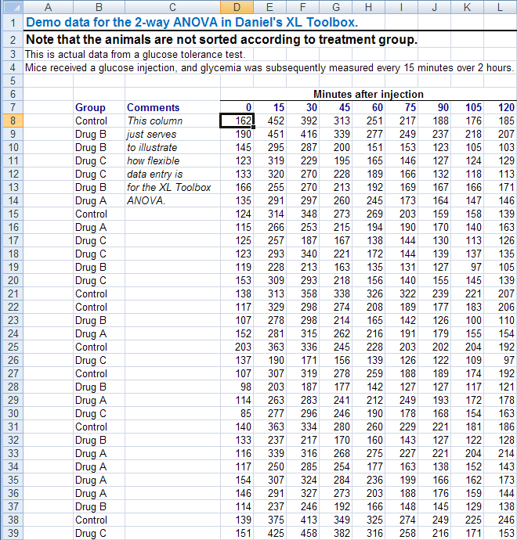
Population
Data description and analysis
Data
Results and
Conclusions
Sample
Notes:
Today we will talk a little bit about sampling, data description, and probability.
Probability is integral to statistical theory, for showing that methods work.

Slide 7
Defining your Population: Population to Sample
Target population
Intended sample
Actual sample
Source population
Who you want to generalize to
Who you have access to
Who you plan to sample
Analysis sample
Notes:
Choosing a representative & feasible sample
Balancing science & practicality

Slide 8
Does elevated systolic blood pressure (BP) increase risk of dementia in elderly persons?
Target population = US People age > 70
Intended sample= age > 70, Medicare, LA county
Actual sample = age > 70, Medicare, LA county, responded to invitation, eligible
Source population = age > 70, enrolled in Medicare
Who you want to generalize to
Who you have access to
Who you plan to sample
Analysis sample
Notes:
Choosing a representative & feasible sample
Balancing science & practicality

Slide 9
Parameters
Parameters are characteristics of the population we want to study
Example: Does elevated systolic blood pressure (BP) increase risk of dementia in elderly persons?
Population | Parameters
US residents, age >70 | Mean blood pressure (BP) Correlation between BP and cognitive test score

Slide 10
Estimates
Characteristic of the sample analogous to that of the population under study
Sample | Estimates
Sample of 1,000 US residents age > 70 | Mean BP in the sample Correlation between BP and cognitive test score in the sample

Slide 11
How is it possible to learn about an entire population just by looking at small portion of it?
Samples usually represent a very small proportion of the entire population (e.g. poll of 1,000 people vs. over 300M US population)
A random sample (of sufficient size) is very likely to be representative of the population (i.e. with high probability.
Equivalently, of all the possible random samples we can draw from a population very few are going to be ‘misleading’
Notes:
Stratified sampling
- BP by diabetic status (type I or II) or obesity
- heights of males and females

Slide 12
Error I
error = difference between parameter estimate (sample) and parameter (population) due to:
Random variation
Sample size is (much) smaller than population size.
Estimate would change if take another sample
Error is unavoidable but gets smaller as sample size increases
Error can be quantified using probability (mathematical statistics is all about this)

Slide 13
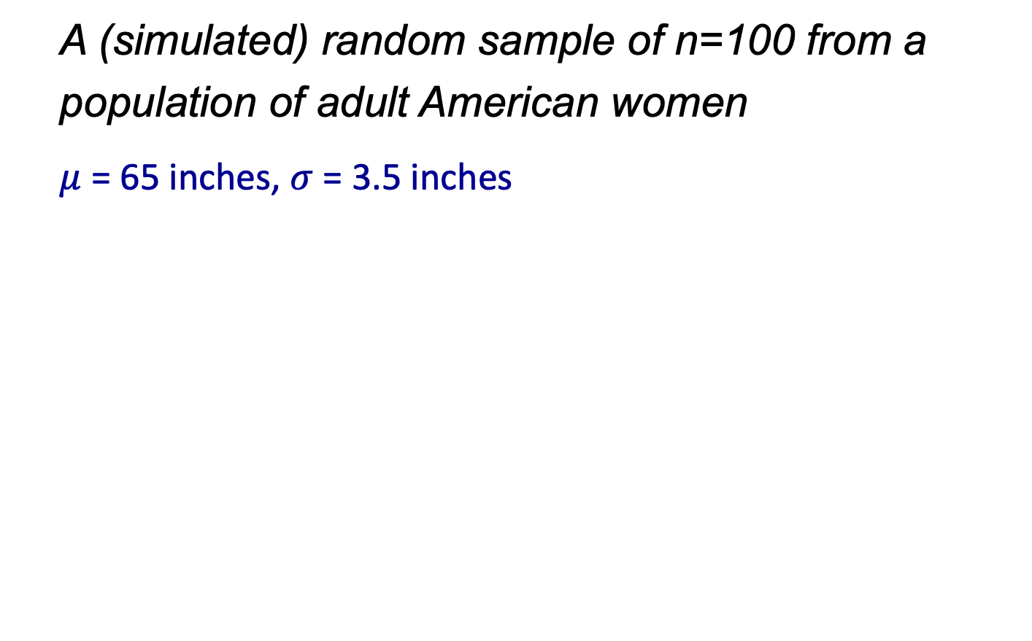
Example
A (simulated) random sample of n=100 from a population of adult American women
$μ$ = 65 inches, $σ$ = 3.5 inches
Notes:
$$μ$$

Slide 14
Example
6 more samples of size 100 from the same population:
Notes:
$$μ$$

Slide 15
Example
Repeat simulation 100 times, and calculate the mean height in each sample.
Question: How often do you think we’ll get a ‘misleading sample’, say one in which the mean is 2 inches away either way from the true mean of 65 inches?
Notes:
$$μ$$

Slide 16
Example
Notes:
$$μ$$

Slide 17
Example
How about 1000 simulations?
How often do you think we’ll get a ‘misleading sample’, say one in which the mean is 2 inches away either way from the true mean of 65 inches?
Notes:
$$μ$$

Slide 18
Example
Notes:
$$μ$$

Slide 19
Error II
ii) Biased sampling
Sample is not representative of the population.
Error does not get smaller with larger sample: bias
Hard to quantify
Try to prevent by good study design
Example: estimate blood pressure from a sample from a diabetes clinic. Why is this likely to be a biased selection?
Notes:
Biased because diabetics are typically more overweight than general population.
=> BP in sample likely will be higher in sample than in population.

Slide 20
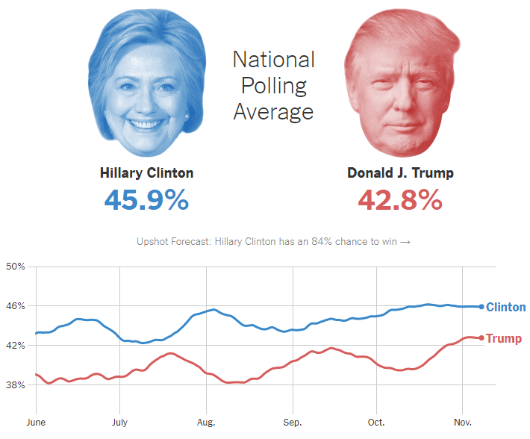
Sampling fail: 2016 presidential election polls
Polls predicted Clinton win
→ WRONG! Why?
Likely polling problems:
Nonresponse bias: certain groups of people didn’t respond
Turnout: Sample not representative of election day voters
Late momentum for Trump (many polls stopped mid-Oct)
Dishonesty in response to poll questions
Some state polls (esp. key states) were off
https://www.nytimes.com/interactive/2016/us/elections/polls.html
A USC poll did get it right: https://www.latimes.com/politics/la-na-pol-convention-bounce-20160725-snap-htmlstory.html
Notes:
https://en.wikipedia.org/wiki/Nationwide_opinion_polling_for_the_2016_United_States_presidential_election#cite_note-274
Education was a key factor, not fully accounted for in some polling methods (e.g. weights)
Electoral college: Michigan, Wisconsin, Pennsylvania
Popular vote: Clinton=48.5, Trump=46.4
Russia?

Slide 21
Types of Samples
Sample of convenience – take who you can get
Easy to obtain
Bias may be a problem
Random sample – every individual in the population has an equal chance of being sampled
Ideal: eliminates systematic factors that can bias results
may be difficult to obtain
More complex random sampling to reduce error/sample size, e.g stratified sampling
Notes:
Stratified sampling
- BP by diabetic status (type I or II) or obesity
- heights of males and females

Slide 22
Randomness assumption
Although most observational studies are not strictly based on a random sample, a good study would attempt to take a sample that is representative of the target population
Statistical methods typically assume the sample is random
Notes:
Population =All CF cases
Sample = patients in a CF clinic
Cystic fibrosis is a autosomal recessive genetic disorder affecting mainly the lungs: thick mucus, frequent infections, shortness of breath
FVC = forced vital capacity = total volume of air that can be forcibly exhaled after a full inspiration (mean values are 4.8L and 3.7L for adult males and females respectively)
FEV1 = forced expiratory volume in 1 second = volume exhaled at the end of the first second of force expiration

